Slide 1
Effects of Rise/Fall Times
on Signal Spectra
John McCloskey
NASA/GSFC Chief EMC Engineer
Code 565
301-286-5498
John.C.McCloskey@nasa.gov

Slide 2
Purpose of Demo/Tutorial
Demonstrate the relationship between time domain and frequency domain representations of signals
In particular, demonstrate the relationship between rise/fall times of digital clock-type signals and their associated spectra
Fast rise/fall times can produce significant high frequency content out to 1000th harmonic and beyond
Common cause of radiated emissions that can interfere with on-board receivers
Can be reduced by limiting rise/fall times

Slide 3
Topics
Sinusoid: Time Domain vs. Frequency Domain
Fourier series expansions of:
Square wave
Rectangular pulse train
Trapezoidal waveform
Comparison to measured results for these waveforms
Observations

Slide 4
Sinusoid: Time Domain vs. Frequency Domain
TIME DOMAIN
FREQUENCY DOMAIN
A
Amplitude
f
Frequency

Slide 5

Fourier Series Expansion of Signal Waveforms
Recommended reading for an in-depth look at Fourier series expansions of signal waveforms:
Clayton Paul, “Introduction to Electromagnetic Compatibility,” sections 3.1 and 3.2

Slide 6
Fourier Series Expansion of Square Wave
Odd harmonics only

Slide 7
Fourier Series Expansion of Rectangular Pulse Train
Even harmonics included
sin(x)/x
(next slide)
NOTE: For 50% duty cycle (τ/T = 0.5), this equation reduces to that for the square wave on the previous slide.

Slide 8
Response and Envelope of sin(x)/x
Response of |sin(x)/x|:
0 for x = nπ
1/x for x = (n+1)π/2
Envelope of |sin(x)/x|:
1 for x < 1
1/x for x > 1
Lines meet at x = 1

Slide 9
Envelope of Rectangular Pulse Train Spectrum
DC offset
Low frequency “plateau”
Harmonic response
0 dB/decade
-20 dB/decade
etc…
f₁
f₂
f₃
f₄
f₅
f
PULSE WIDTH

Slide 10
Fourier Series Expansion of Trapezoidal Waveform
A
τ
NOTE: τ_{r} and τ_{f} are generally measured between 10% and 90% of the minimum and maximum values of the waveform.
τ_{r}
τ_{f}
T
Assume τ_{r} = τ_{f} :
Additional sin(x)/x term due to rise/fall time

Slide 11
Envelope of Trapezoidal Waveform Spectrum
DC offset
Low frequency “plateau”
Harmonic response
(pulse width)
Harmonic response
(rise/fall time)
0 dB/decade
-20 dB/decade
-40 dB/decade
etc…
f₁
f₂
f₃
f₄
f₅
f
PULSE WIDTH
RISE/FALL TIME

Slide 12
Trapezoidal Waveform Spectrum (Simplified)
Slower rise/fall times provide additional roll-off of higher order harmonics
0 dB/decade
-20 dB/decade
-40 dB/decade
f
PULSE WIDTH
RISE/FALL TIME

Slide 13
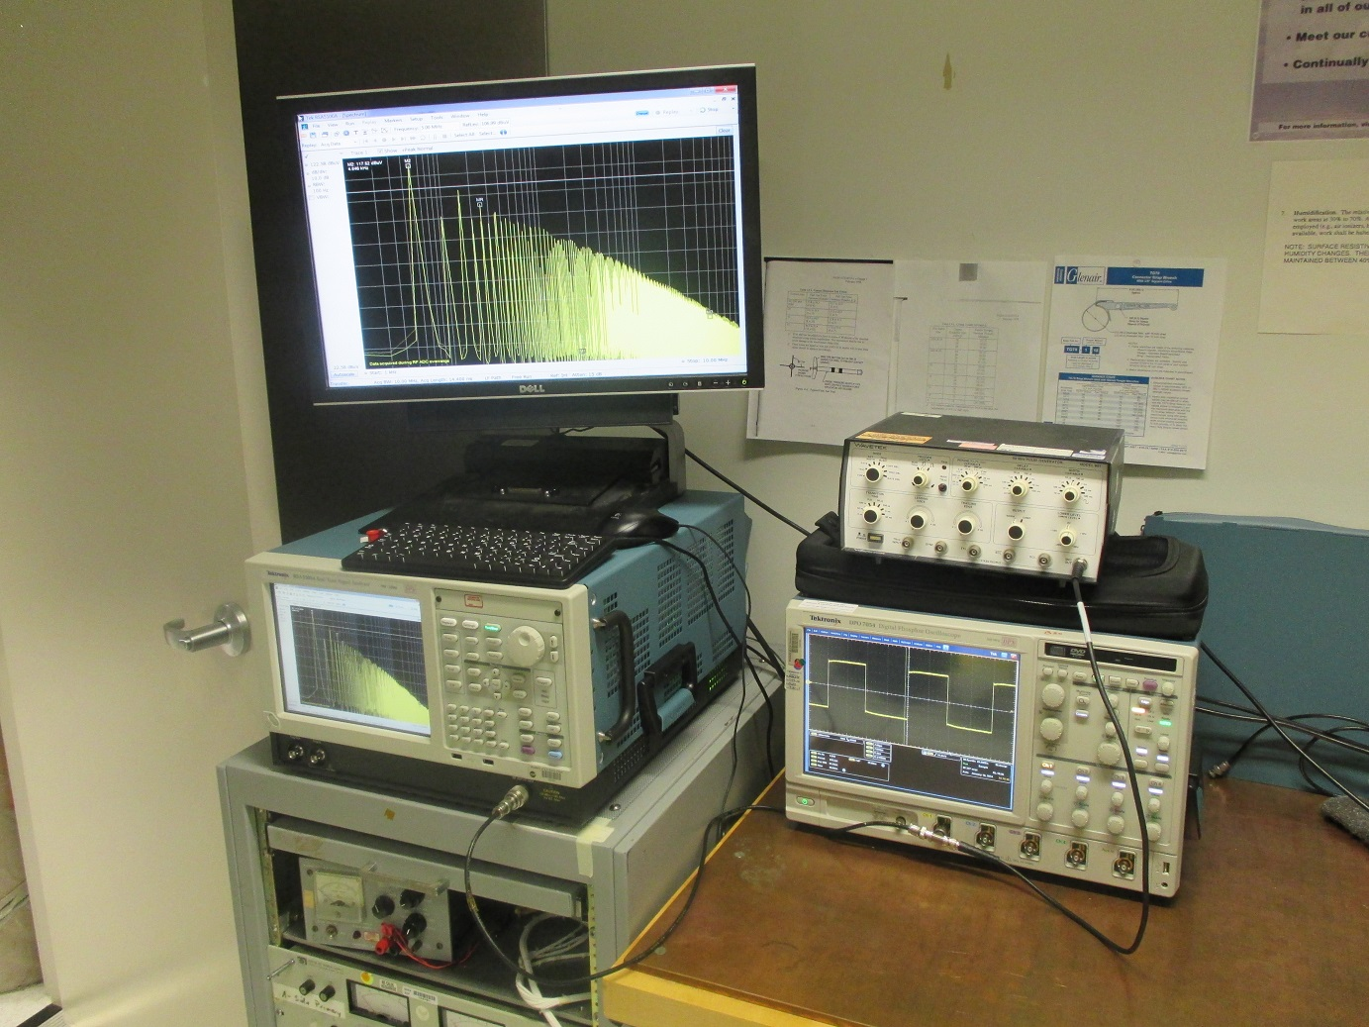
Test Setup
WAVETEK 801 pulse generator
TEKTRONIX RSA5103A spectrum analyzer
(50 Ω input)
TEKTRONIX DPO7054 oscilloscope
(1 MΩ input)

Slide 14
Applied Waveform
A
τ
τ_{r}
τ_{f}
T
A = 1 V
T = 200 µs
(f₀ = 5 kHz)
τ, τ_{r} , & τ_{f} varied as indicated on following slides

Slide 15
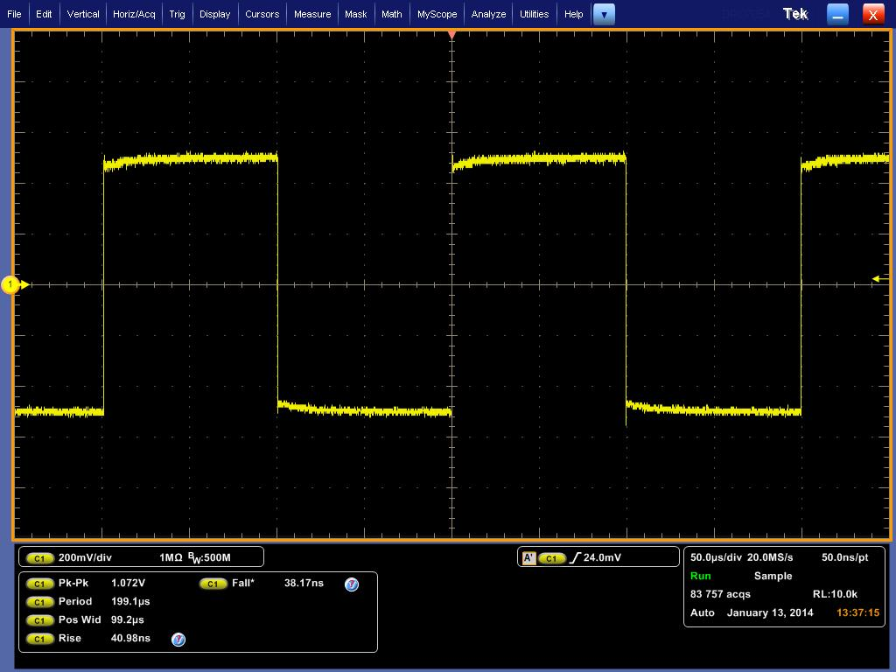
τ = 100 µs; τ_{r} = τ_{f} = 40 ns
τ/T = 50%
2A(τ/T) = 1 V
= 120 dBµV

Slide 16

τ = 100 µs; τ_{r} = τ_{f} = 360 ns
τ/T = 50%
2A(τ/T) = 1 V
= 120 dBµV

Slide 17

τ = 100 µs; τ_{r} = τ_{f} = 3.6 µs
τ/T = 50%
2A(τ/T) = 1 V
= 120 dBµV

Slide 18
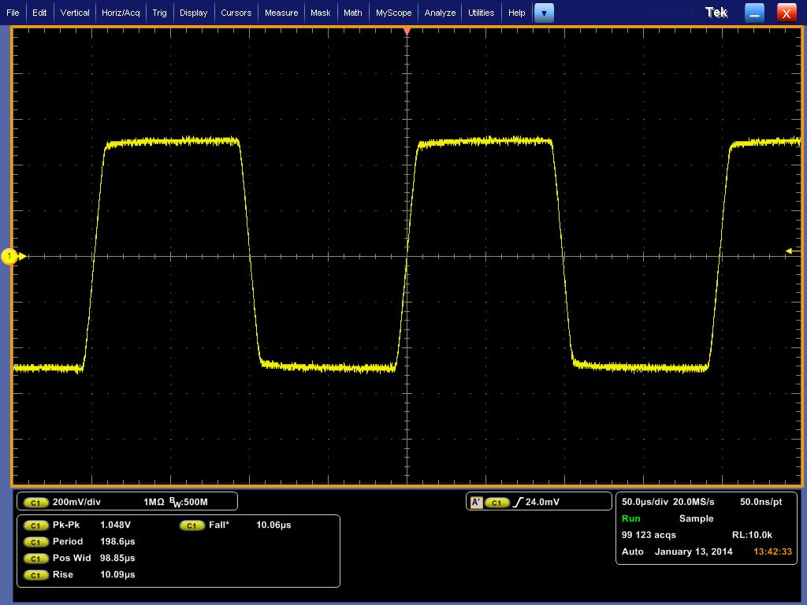
τ = 100 µs; τ_{r} = τ_{f} = 10 µs
τ/T = 50%
2A(τ/T) = 1 V
= 120 dBµV

Slide 19
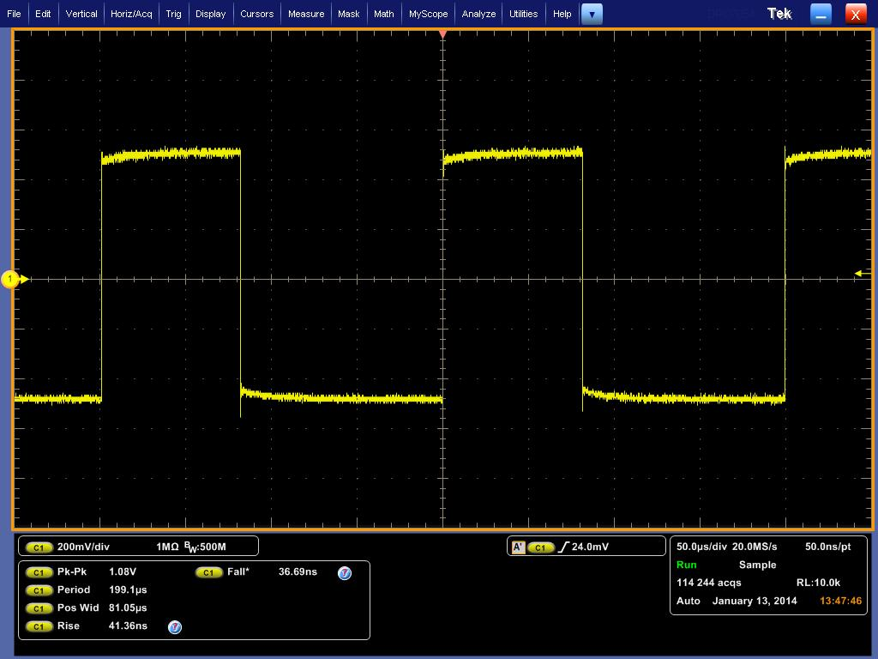
τ = 80 µs; τ_{r} = τ_{f} = 40 ns
τ/T = 40%
2A(τ/T) = 0.8 V
= 118 dBµV

Slide 20
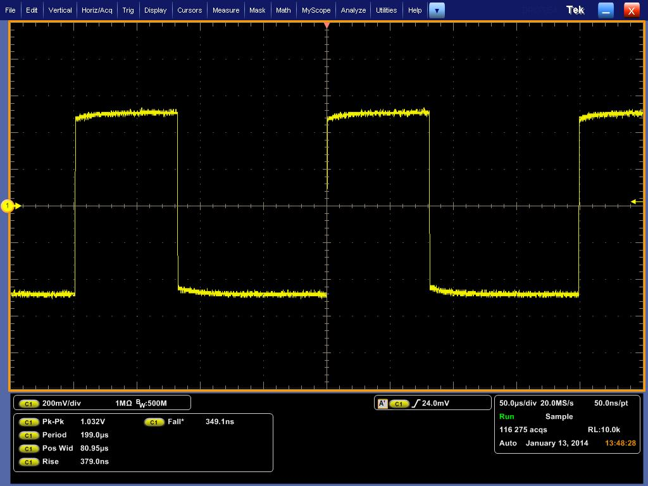
τ = 80 µs; τ_{r} = τ_{f} = 360 ns
τ/T = 40%
2A(τ/T) = 0.8 V
= 118 dBµV

Slide 21

τ = 80 µs; τ_{r} = τ_{f} = 3.3 µs
τ/T = 40%
2A(τ/T) = 0.8 V
= 118 dBµV

Slide 22
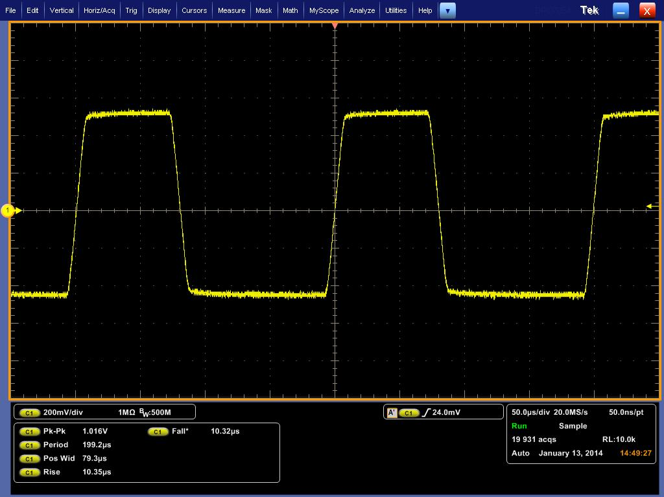
τ = 80 µs; τ_{r} = τ_{f} = 10 µs
τ/T = 40%
2A(τ/T) = 0.8 V
= 118 dBµV

Slide 23
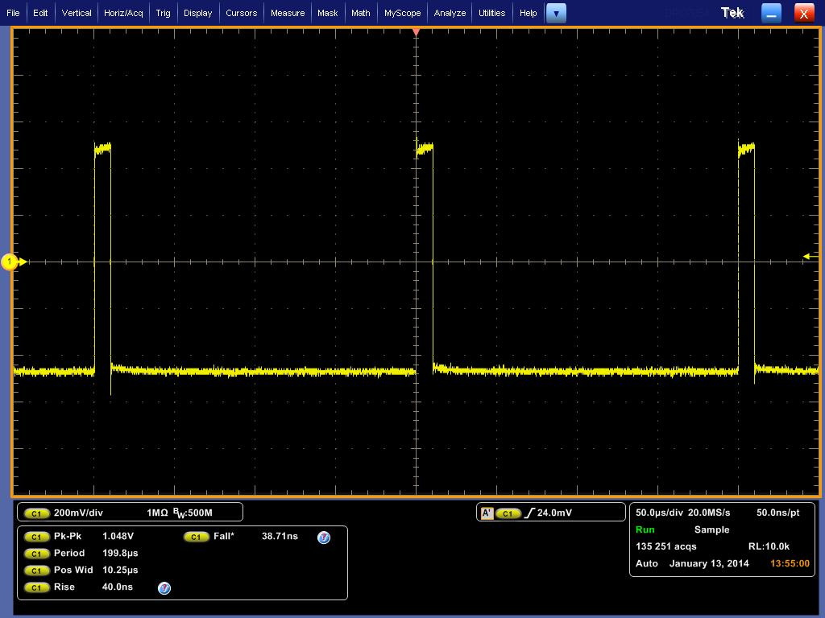
τ = 10 µs; τ_{r} = τ_{f} = 40 ns
τ/T = 5%
2A(τ/T) = 0.1 V
= 100 dBµV

Slide 24
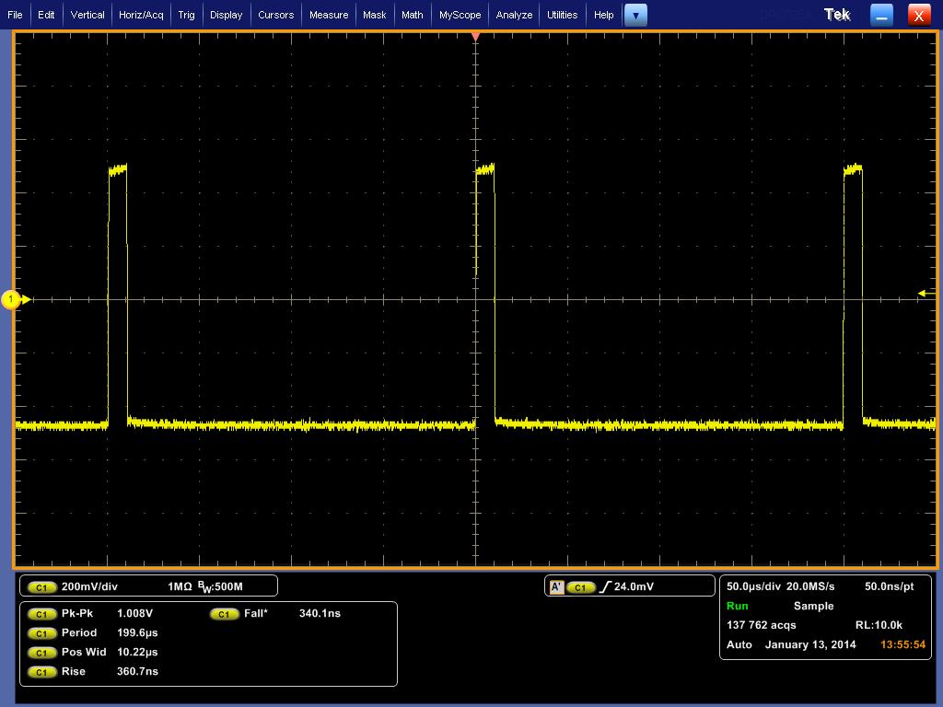
τ = 10 µs; τ_{r} = τ_{f} = 350 ns
τ/T = 5%
2A(τ/T) = 0.1 V
= 100 dBµV

Slide 25
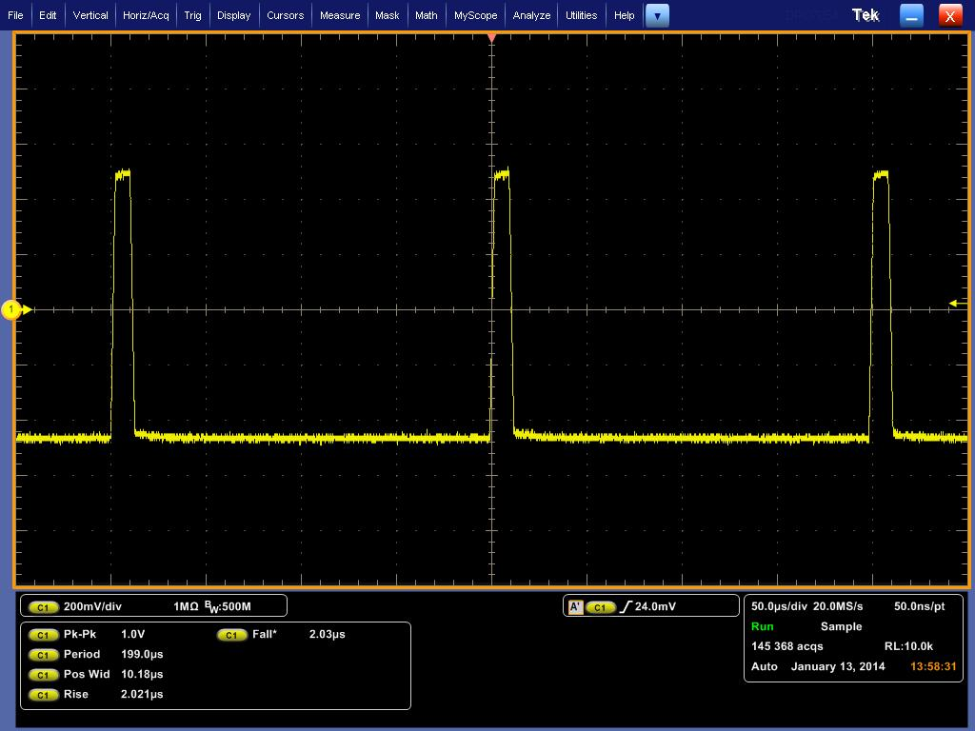
τ = 10 µs; τ_{r} = τ_{f} = 2 µs
τ/T = 5%
2A(τ/T) = 0.1 V
= 100 dBµV

Slide 26
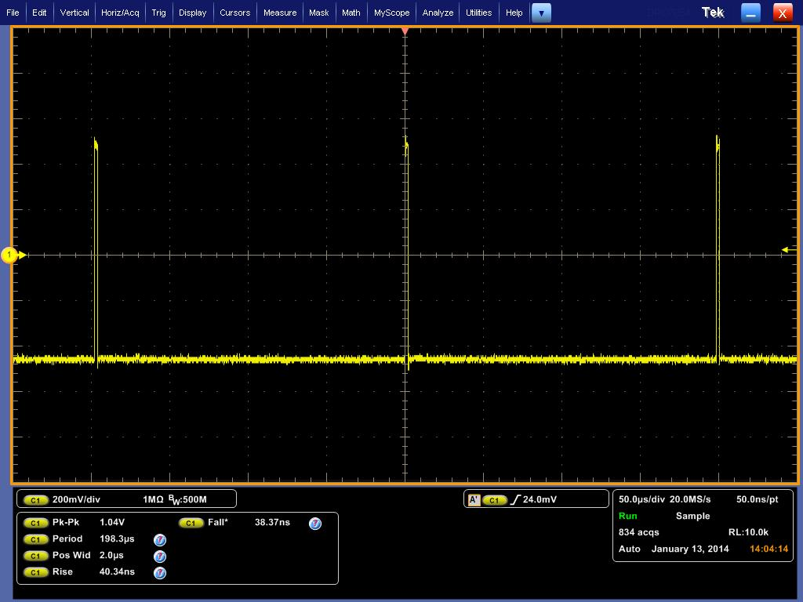
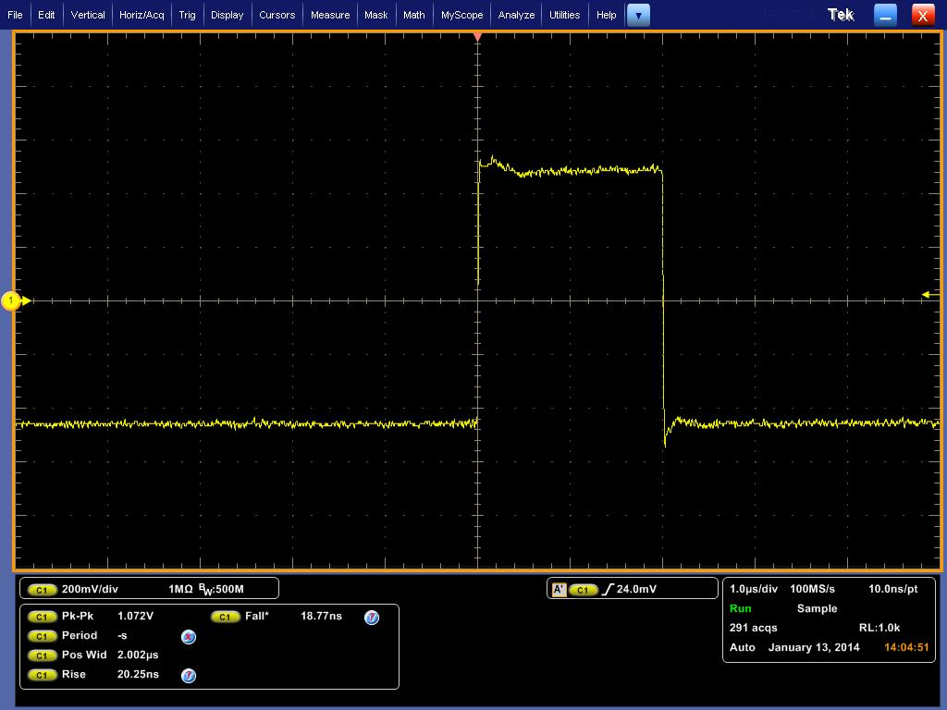
τ = 2 µs; τ_{r} = τ_{f} = 160 ns
τ/T = 1%
2A(τ/T) = 0.02 V
= 86 dBµV

Slide 27
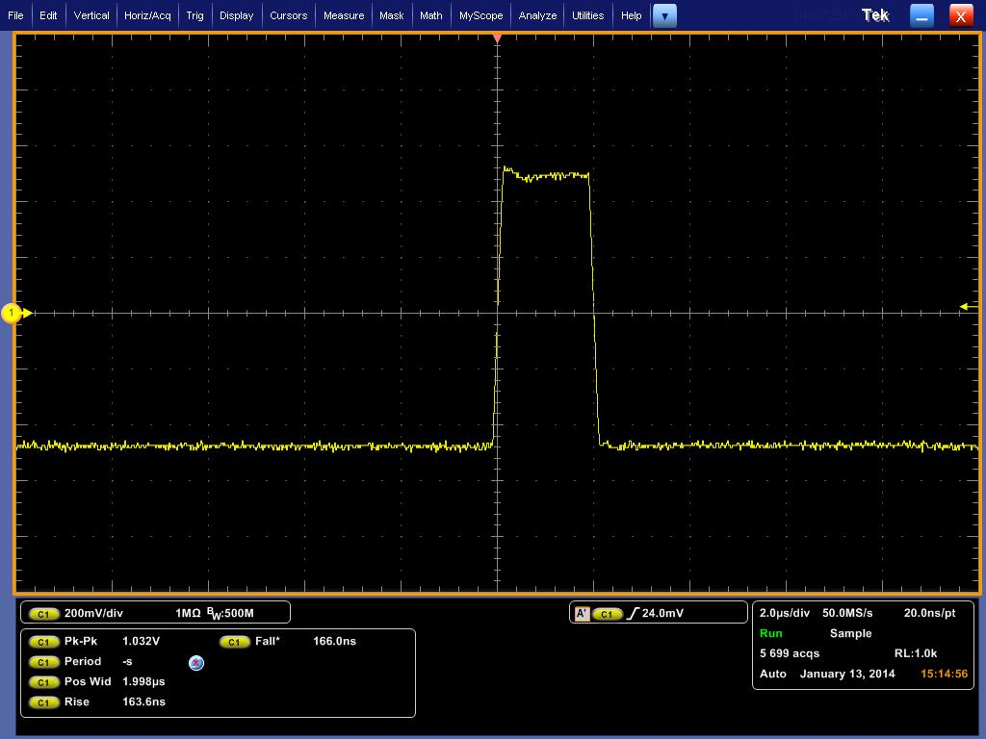
τ = 2 µs; τ_{r} = τ_{f} = 20 ns
τ/T = 1%
2A(τ/T) = 0.02 V
= 86 dBµV

Slide 28
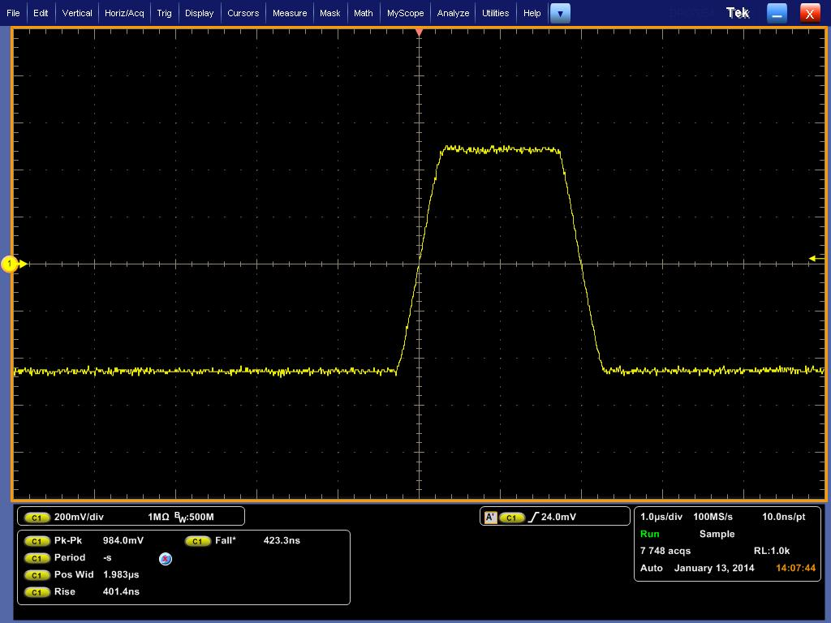
τ = 2 µs; τ_{r} = τ_{f} = 400 ns
τ/T = 1%
2A(τ/T) = 0.02 V
= 86 dBµV

Slide 29
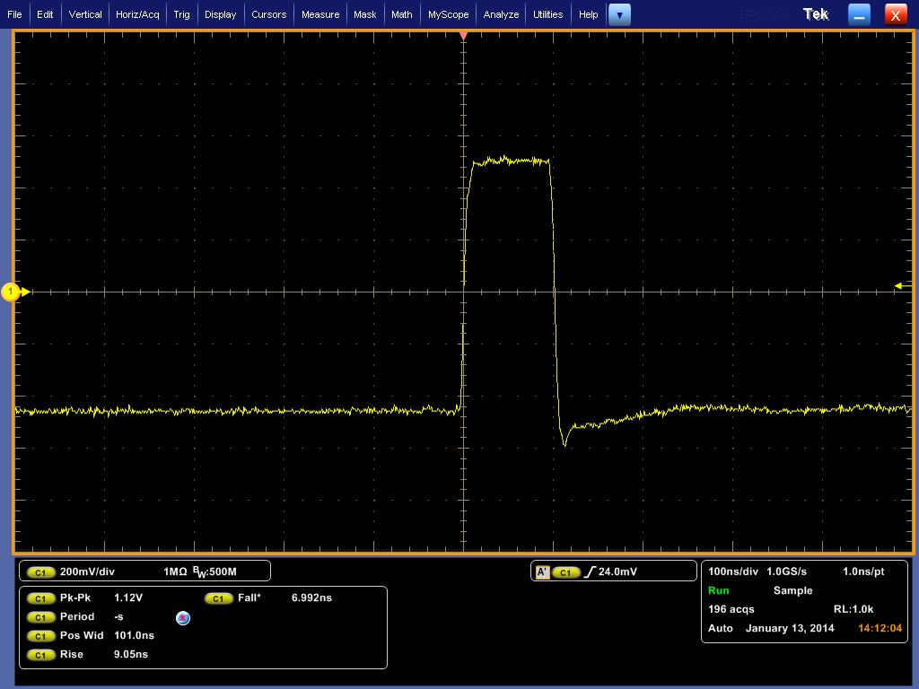
τ = 100 ns; τ_{r} = τ_{f} = 8 ns
τ/T = 0.05%
2A(τ/T) = 1 mV
= 60 dBµV

Slide 30
Observations (1 of 2)
Measured spectra show good agreement with expected values
“3-line” envelope provides simple, accurate, and powerful analytical tool for correlating signal spectra to trapezoidal waveforms
Even harmonics
Reduced, but not zero, amplitude for 50% duty cycle
Varying amplitude for other than 50% duty cycle
Must be considered as potentially significant contributors to spectrum
Low frequency plateau scales with duty cycle
Spectrum for low duty cycle waveforms gives artificial indication of low amplitude
First “knee” frequency may be quite high, producing relatively flat spectrum for many harmonics (100s or 1000s in these examples)
Low duty cycle waveforms should be observed in time domain (oscilloscope) as well as frequency domain (spectrum analyzer)

Slide 31
Observations (2 of 2)
Signal spectra significantly more determined by rise/fall times than by fundamental frequency of waveform
Uncontrolled rise/fall times can produce significant frequency content out to 1000th harmonic and beyond
Common cause of radiated emissions
5 MHz clock can easily produce harmonics out to 5 GHz and beyond
Potential interference to S-band receiver (~2 GHz), GPS (~1.5 GHz), etc.
Controlling rise/fall times can significantly limit high frequency content at source
LIMIT THOSE RISE/FALL TIMES!!!

Slide 32
Questions/Comments
Contact:
John McCloskey
NASA/GSFC Chief EMC Engineer
Phone: 301-286-5498
E-mail: John.C.McCloskey@nasa.gov

